Slide 1
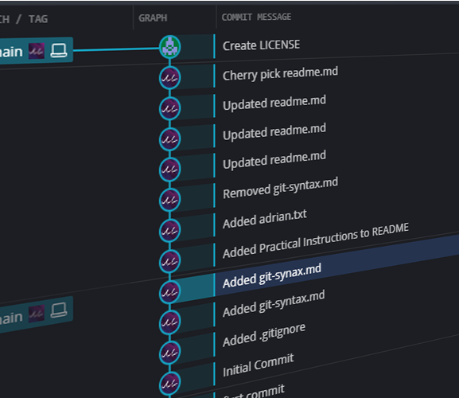
Git Good With Adrian
Git & GitHub workshop
Learn the basics of Git!
Essential skill in college and industry.

Slide 2
Outline
Introduction to Git
Fun Stuff – Visual Practice
Git Basics
Git Branches
Introduction to GitHub
Practice
Additional Tools

Slide 3
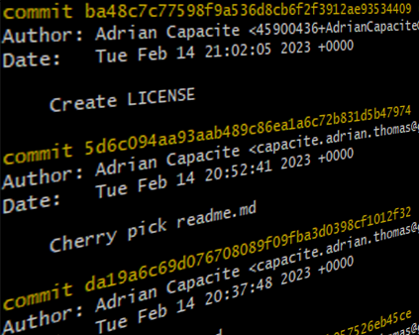
What Is Git?
Notes:
Distributed – Copies of files are stored in multiple locations

Slide 4

What Is Git?
Free & Open Source
Distributed Version Control System
Repository
Remote
Local
Branching
Git != GitHub
Notes:
Distributed – Copies of files are stored in multiple locations

Slide 5
Importance of Git
Every company will use it, whys that?
Version Control
Collaboration
Backup & disaster recovery
Speed & Efficient
Open Source (No fees)
Notes:
In industry: Pull requests
everything done through pull requests
commits tell a story of whats changed
descriptions with error messages and comments
before merging branches a few commits are squashed into a single commit (easier to review when something breaks)
Tags
commits would link to a task in a task management system (workday uses a tool called JIRA)
also add
unit tests
screen shots

Slide 6
Git Basic Commands
git clone – Makes copy of Remote Repo onto Local machine
git pull – Fetch & Merge Commits Local => Remote
git push – Copy & Merge Commits Local <= Remote
git add – Add changes made in CWD to Index (Staging)
git commit -m – Commit changes to local repo with message
git checkout – Show branch/commit in working directory (cd)

Slide 7
Git Basic Commands Syntax
git clone <remote_repo>
git pull <remote_repo>
git push <remote_repo> <branch>
git add [<dir>|<file>]
git commit -m <message>
git checkout [<branch>|<commit>]

Slide 8

Git Basics: Version Control
HEAD
‘main’
‘Initial commit’
‘Add new feature’
‘Squashed bug’

Slide 9
Git Basics: Version Control
‘Add new feature’
HEAD
‘main’
‘Initial commit’
‘Merge new feature’
‘Squashed bug’

Slide 10




Git Basics
Working
Directory
Local Repository
Remote Repository
Index
git add
git commit
git push
git checkout
git pull
Notes:
Working directory: Is the direct folder you can see in your file explorer, here you make your changes
Index: Is where the chang

Slide 11
Git Basics
Working
Directory
Local Repository
Remote Repository
Local Machine 1

Slide 12
Git Basics
Working
Directory
Local Repository
Remote Repository
Local Machine 1
Local Machine 2

Slide 13
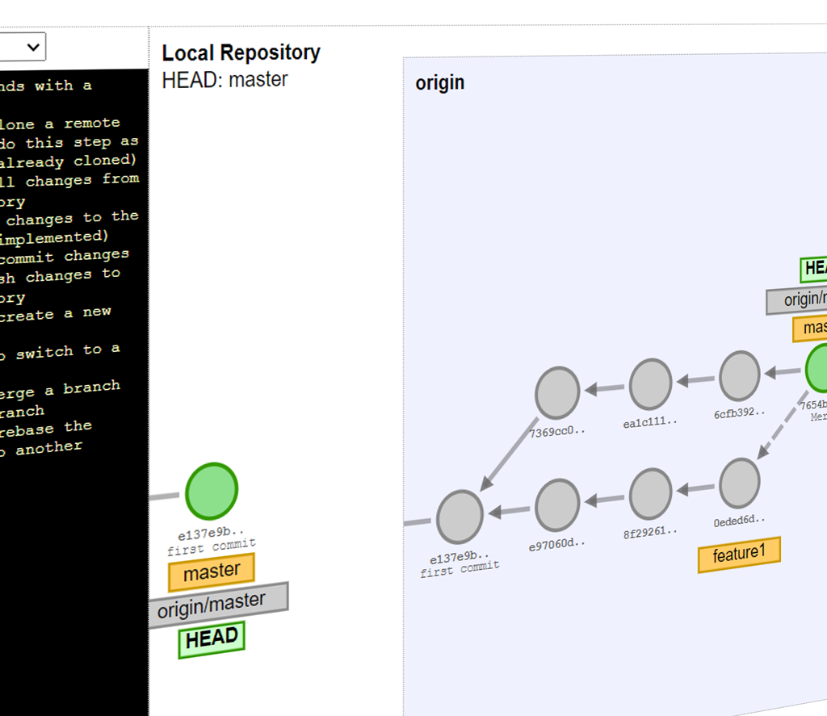
Git Visual Practice
Time for fun!
https://adriancapacite.github.io/visualizing-git/#practice-with-remote

Slide 14
Git Visual Practice
https://adriancapacite.github.io/visualizing-git/#practice-with-remote
Firstly pull commits from the remote ‘origin’.
Make 2 commits to your local repo. Each commit has one of the following message respectively: [‘Git’, ‘Good’].
Finally push your commits to the remote.
Notes:
The HEAD points to the latest change on a branch that you are currently working on

Slide 15
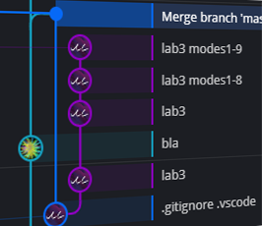
Git Branching
Make changes without affecting

Slide 16
Git Branching Commands
git branch – Create new branch from current branch
git checkout – Switch to branch or
git merge – Copy & Merge Commits Local <= Remote
git rebase – Add changes made in working dir to Staging

Slide 17
Git Branching
‘Add new feature’
HEAD
‘feature1’
‘main’
‘Initial commit’
‘Merge new feature’
‘Squashed bug’

Slide 18
Git Branching Visual Practice
https://adriancapacite.github.io/visualizing-git/#practice-branching
Create a new branch named 'feature1' and switch to it.
Make a commit in the 'feature1' branch.
Switch to the 'main' branch and pull in the latest changes from the remote 'origin'.
Switch back to the 'feature1' branch and merge the new changes from 'main' into it.
Switch to the 'main' branch and merge the 'feature1' branch into it.
Finally, delete the 'feature1' branch.

Slide 19
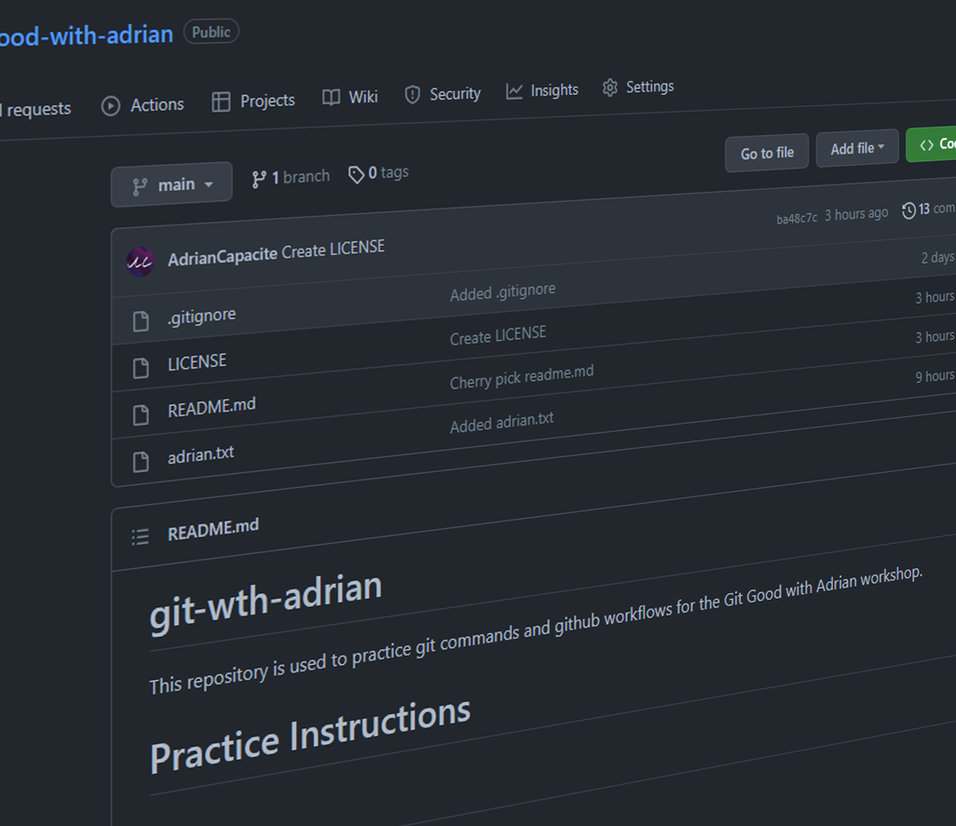
GitHub
www.github.com
www.gitbucket.org

Slide 20
What is GitHub
Web-based Git platform
Provides more than just a Git server:
Collaboration – Pull Request, Code Reviews
Automation & CI/CD – Actions
Security – Vulnerability reports, Dependabot alerts
Project Management – Projects, Issues, Wikis
Community – Sharing, Sponsoring

Slide 21
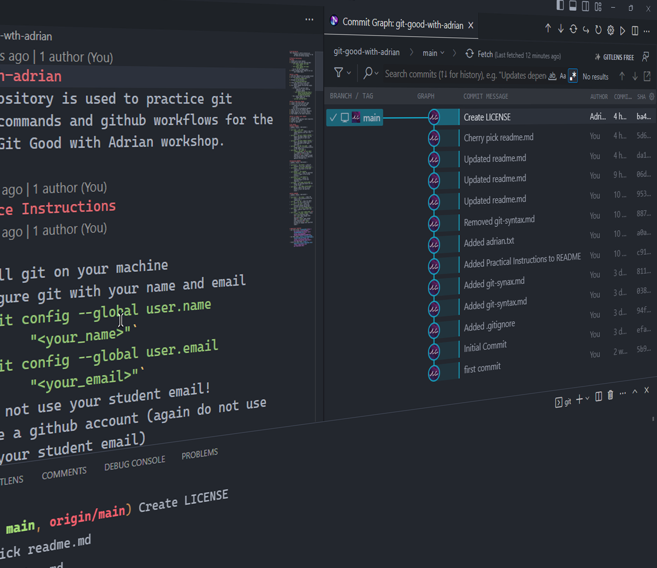
Git & GitHub: Putting it all together
https://www.github.com/AdrianCapacite/git-good-with-adrian/

Slide 22
More Git Commands
git revert – Undo existing commit
git reset – Reset current HEAD to the specified commit
--soft – Keeps changes in Index (Staged)
--mixed – Keeps changes only in Working Directory (Unstaged)
--hard – Discard all changes
git rebase – Reapply commits on top of another base tip of current branch
git tag – Labels a commit to make for easy referencing
Notes:
Git tags are commonly used for several purposes:
Version control: You can use Git tags to label releases of your software or other projects, making it easy to identify and refer to specific versions in the future.
Bookmarking: Git tags can be used to bookmark specific points in the history of your repository, making it easy to return to that state later.
Binary assets: If you have binary assets in your repository, such as images or compiled executables, you can use Git tags to mark specific versions of those assets.
Collaboration: You can use Git tags to coordinate with others on a project. For example, you can tag a version of your code when you're ready for others to review it, or when you want to freeze a version for testing.

Slide 23
More Git Commands
git revert <commit>
git reset [--soft|--mixed|--hard] <commit>
--soft – Keeps changes in Index (Staged)
--mixed – Keeps changes only in Working Directory (Unstaged)
--hard – Discard all changes
git rebase <commit>
git tag <tag_name>
Notes:
Git tags are commonly used for several purposes:
Version control: You can use Git tags to label releases of your software or other projects, making it easy to identify and refer to specific versions in the future.
Bookmarking: Git tags can be used to bookmark specific points in the history of your repository, making it easy to return to that state later.
Binary assets: If you have binary assets in your repository, such as images or compiled executables, you can use Git tags to mark specific versions of those assets.
Collaboration: You can use Git tags to coordinate with others on a project. For example, you can tag a version of your code when you're ready for others to review it, or when you want to freeze a version for testing.

Slide 24
More Git Commands
git revert – Undo existing commit
git reset – Reset current HEAD to the specified commit
--soft – Keeps changes in Index (Staged)
--mixed – Keeps changes only in Working Directory (Unstaged)
--hard – Discard all changes
git rebase – Reapply commits on top of another base tip (Branch)
git tag – Labels a commit to make for easy referencing
Notes:
Git tags are commonly used for several purposes:
Version control: You can use Git tags to label releases of your software or other projects, making it easy to identify and refer to specific versions in the future.
Bookmarking: Git tags can be used to bookmark specific points in the history of your repository, making it easy to return to that state later.
Binary assets: If you have binary assets in your repository, such as images or compiled executables, you can use Git tags to mark specific versions of those assets.
Collaboration: You can use Git tags to coordinate with others on a project. For example, you can tag a version of your code when you're ready for others to review it, or when you want to freeze a version for testing.

Slide 25
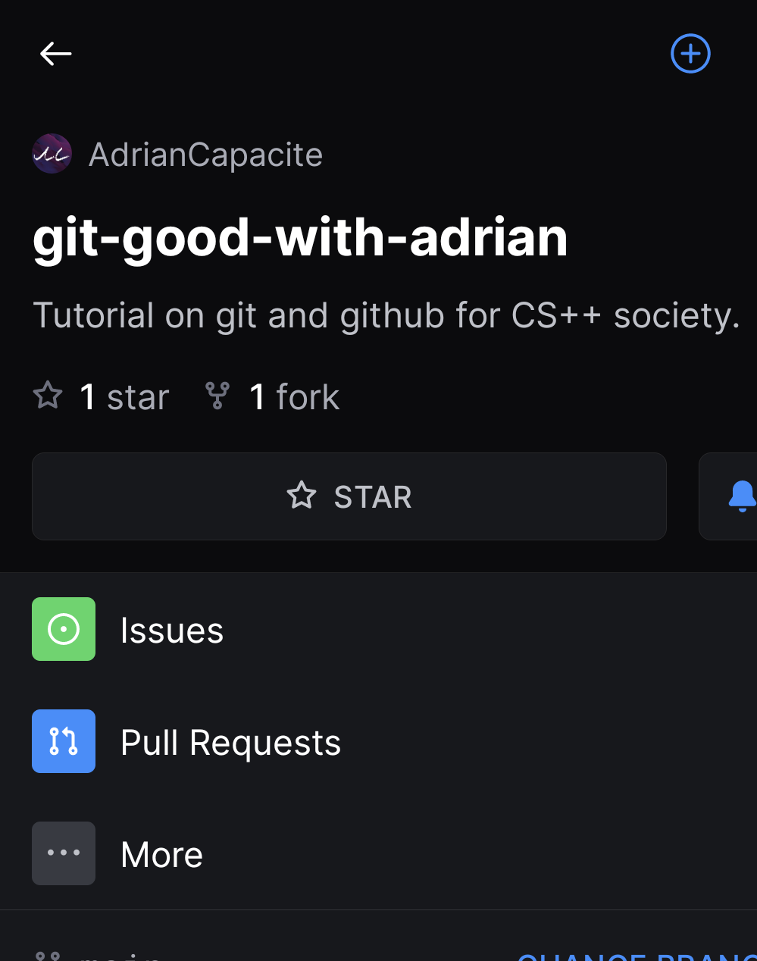
More Git Tools
GitHub Clients: CLI, Desktop, Mobile
GUI: GitKraken, GitLens, Git GUI

Slide 26
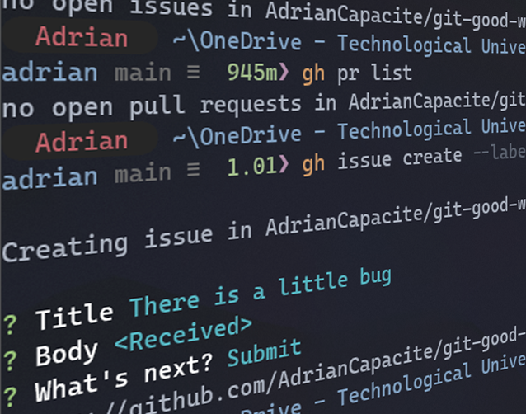
More Git Tools: GitHub CLI
A Command line interface version of github.com
Same features
Allows for streamlined workflows

Slide 27
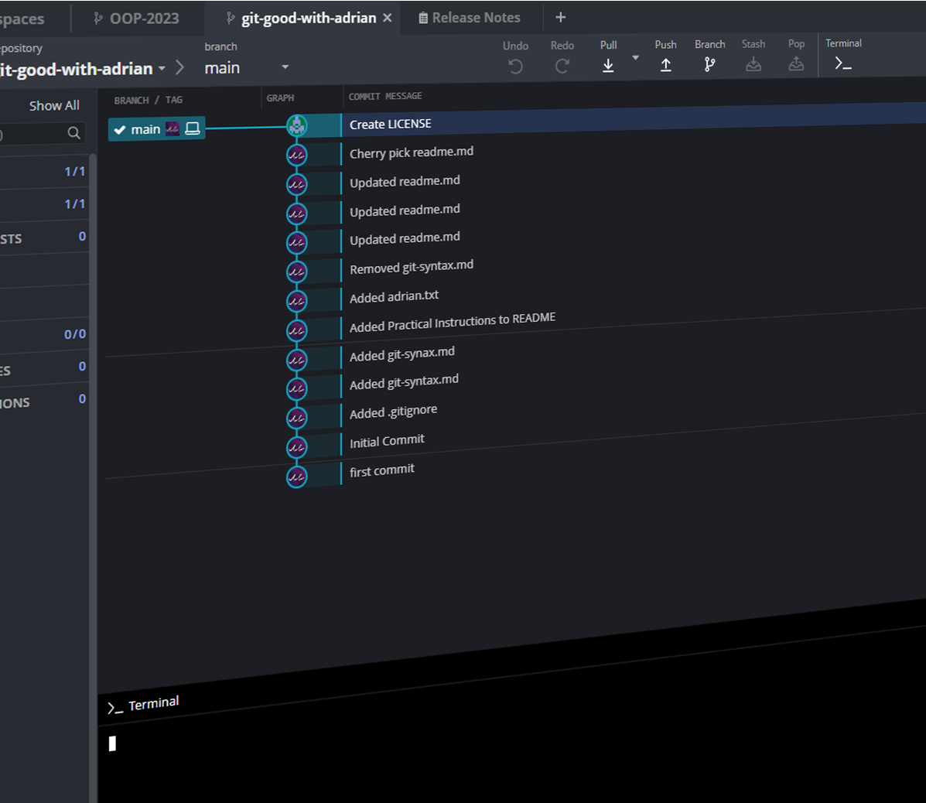
More Git Tools: GitKraken & GitLens
https://www.gitkraken.com/
Stylish Git GUI client
Easy learning of Git and Git commands
Provides more information of repositories
GitKraken – Full GUI Application
Visualisation of git timeline
GitLens – VSCode extension
Similar to GitKraken
Provides information within VSC and inline git blames

Slide 28
Additional Resources
Git Crash course: brandon1024/GITCRASHCOURSE.MD
Git Cheat Sheet: https://training.github.com/downloads/github-git-cheat-sheet/
Visual Git Cheat Sheet: https://ndpsoftware.com/git-cheatsheet.html

Slide 29
Questions?
Chacon, Scott, and Ben Straub. Pro Git, Second Edition. 2nd ed., Apress, 9 Nov. 2014, git-scm.com/book/en/v2. Accessed 12 Feb. 2023.
Git. “Git.” Git-Scm.com, 2019, git-scm.com/. Accessed 12 Feb. 2023.
“Free Git GUI Client - Windows, Mac & Linux | GitKraken.” GitKraken.com, 2019, www.gitkraken.com/. Accessed 14 Feb. 2023.

